Slide 1
Mule Message
课程目标
Introduce mule message
Introduce Mule application and flow
Accessing and Modifying message
Setting message data
Debug Mule Application
Chinasofti MuleSoft Training 2017
Notes:
培训说明和Mulesoft总体介绍(15-25分钟)

Slide 2
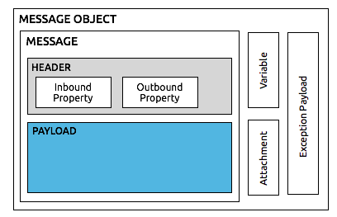
Introduce mule message
什么是mule message?
Mule message is the data that passes through an application via one or more flows.
Mule message consists of two main parts:
The message header, which contains metadata about the message
The message payload, which contains your business-specific data.
Chinasofti MuleSoft Training 2017
Notes:
培训说明和Mulesoft总体介绍(15-25分钟)

Slide 3
Introduce mule message
什么是mule message?
Mule message | HTTP request
Inbound | Header
Outbound | None
Payload | Body
Chinasofti MuleSoft Training 2017
Notes:
培训说明和Mulesoft总体介绍(15-25分钟)

Slide 4
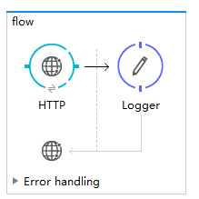
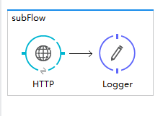
Introduce Mule Application/Flow
什么是mule application?
Mule Application是指由一个或多个flow / subFlow组成的应用程序
Chinasofti MuleSoft Training 2017
Notes:
培训说明和Mulesoft总体介绍(15-25分钟)

Slide 5
Introduce Mule Application/Flow
什么是mule application?
 | Flow | Sub flow
消息源 | Y | N
异常处理模块 | Y | N
能被复用 | Y | Y
Chinasofti MuleSoft Training 2017
Notes:
培训说明和Mulesoft总体介绍(15-25分钟)

Slide 6
Accessing and Modifying message
Variable, Inbound, Outbound, Payload
在anypoint studio上演示
Chinasofti MuleSoft Training 2017
Notes:
在anypoint studio上演示

Slide 7
Thanks
Chinasofti MuleSoft Training 2017
Notes:
培训说明和Mulesoft总体介绍(15-25分钟)

